Slide 1

Housing and Conflict
BLUF: Conflict has impacts on housing depending on both region and US Economy ramifications

Slide 2
Context
Conflict | Event | Time Period | Economic Impact | Housing Outcome
US War | War On Terror | 2001 – 2021 | Economic boom from weapons manufacturing and mobilization | Positive
International Conflict | Arab Spring Crimean Invasion Russia / Ukraine Isreal Hamas Conflict | 2010-2011 2014 2022 → 2023 → | Increased oil prices Increased import /export costs Threat of increased costs | Negative
Economic | 2008 Financial Crisis Us / China Trade War Covid 19 | 2008 – 2012 2018 → 2021 → | Unprecedented swings in the market Severe inflationary policy Severe swings in cost of capital | Dependent
Notes:
1. 9/11 Attacks and War on Terror (2001–2011)
Event: Terrorist attacks (Sep 11, 2001) → U.S. invaded Afghanistan (2001) and Iraq (2003)
Impact:
Surge in defense spending
Fed cut interest rates drastically
Housing prices began to rise post-recession
Military bases (like Fort Liberty near Fayetteville) expanded activity
Real Estate: Boost in demand near military hubs
2. Global Financial Crisis (2007–2009)
Event: U.S. mortgage meltdown triggered global recession
Impact:
Massive job loss, home foreclosures
Fed interest rates dropped to near zero
FHA/VA loan programs expanded
Real Estate: Prices plummeted; military towns often saw less damage than urban markets
3. Arab Spring & Oil Shocks (2011–2014)
Event: Regional uprisings in the Middle East & North Africa destabilized oil supply
Impact:
Gas prices rose sharply
Modest inflation pressure
Increased U.S. military deployment
Real Estate: Higher commuting costs hurt suburbs; military town economies grew
4. Russia-Ukraine Tensions Begin (2014)
Event: Russia annexed Crimea
Impact:
U.S. imposed sanctions
NATO military readiness increased
Real Estate: Little short-term impact, but Fort Liberty deployment volume rose
5. U.S.-China Trade War (2018–2019)
Event: U.S. imposed tariffs on hundreds of billions in Chinese goods
Impact:
Supply chain volatility
Manufacturing and farm exports hit
Fed paused rate hikes due to uncertainty
Real Estate: Stock market volatility dampened luxury housing, but rates stayed low
6. COVID-19 Pandemic & Global Lockdowns (2020–2022)
Event: Global health crisis → widespread economic shutdowns
Impact:
Fed rates dropped to 0%
Stimulus payments & record-low mortgage rates
Massive remote work shift
Real Estate: Home prices skyrocketed (esp. in suburban and military towns like Fayetteville)
7. Russia Invasion of Ukraine (2022–Present)
Event: Full-scale war triggered energy, grain, and supply chain crises
Impact:
Global inflation
U.S. interest rates hiked rapidly (to fight inflation)
Defense spending increased
Real Estate: Mortgage rates surged → cooling market despite high demand
8. Israel–Hamas Conflict Resurgence (2023–Present)
Event: Major regional instability risk in Middle East
Impact:
Elevated oil/gas price risks
Safe-haven capital inflows to U.S.
Real Estate: Higher borrowing costs + inflation hurt affordability
9. Rising U.S.–China Tensions (Ongoing)
Event: Taiwan, chip exports, South China Sea, trade restrictions
Impact:
Long-term reshoring and supply chain shifts
Uncertainty in global capital markets

Slide 3
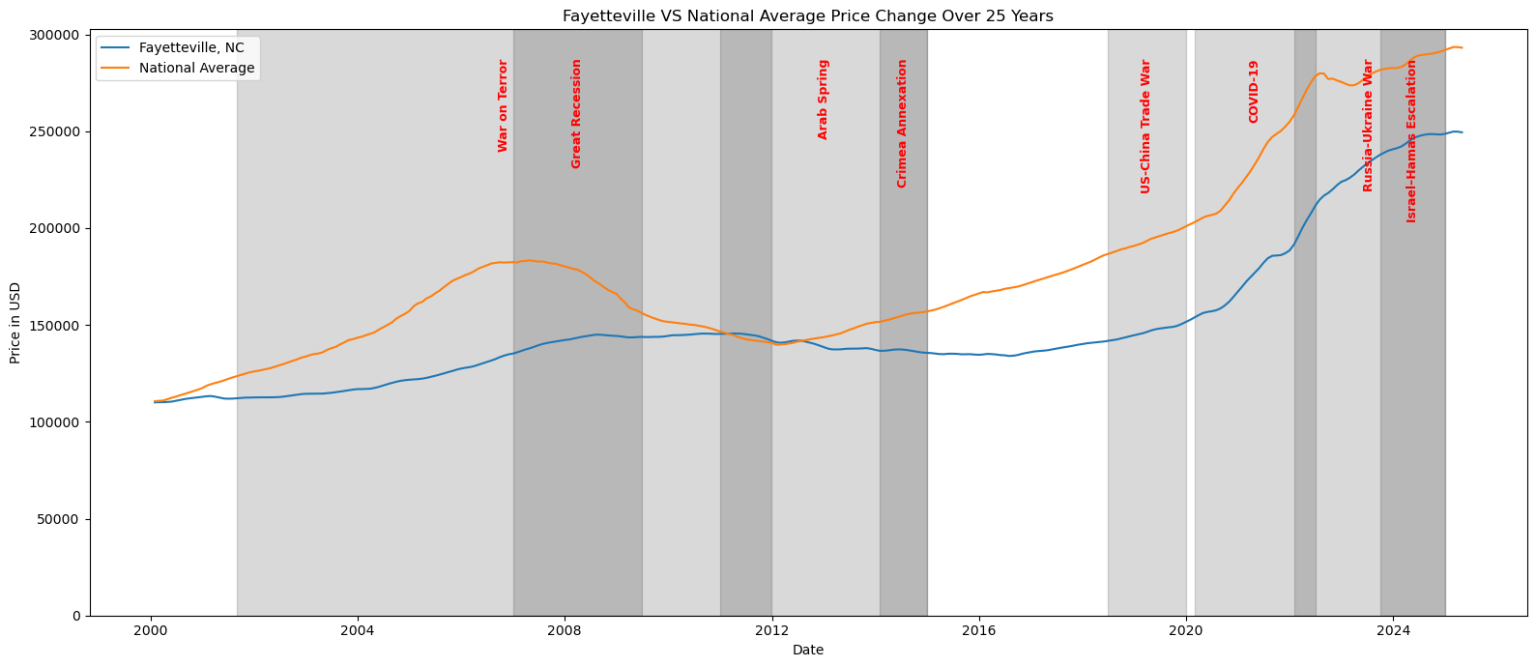
Context
2008 global financial crash fueled by poor oversight of mortgage backed securities and defaulting loan payments
Covid spurred housing price boom beginning in 2020
BLUF: Middle easter conflict has had minimal economic impact on the US housing market which is directly tied to investor confidence in the US economy, overall take away is European conflict and difficulties in trade have far greater impacts on costs and housing market health than other conflicts

Slide 4
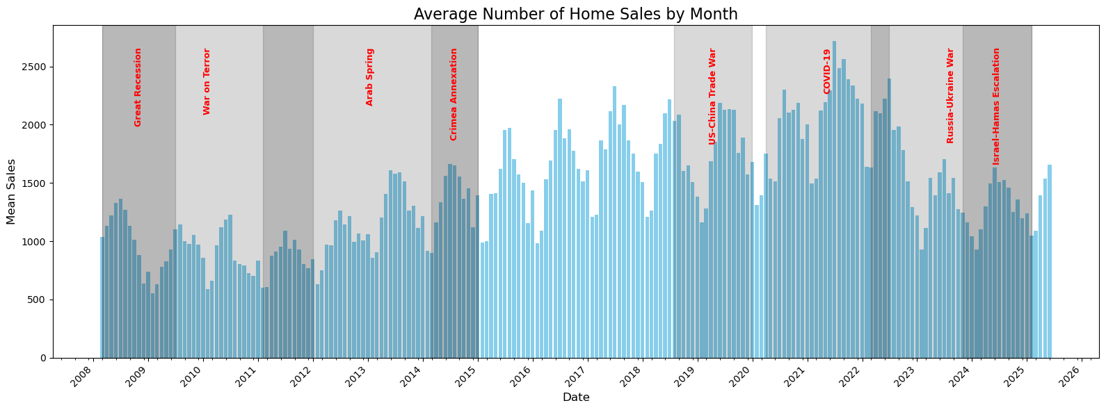
Who’s Buying?
Seasonal fluctuation aside during economic recovery you see minimal year over year change in volume
Overall sales volume increases year over year until the steep Covid -19 boom paired with the staunch interest rate hikes to combat inflation

Slide 5
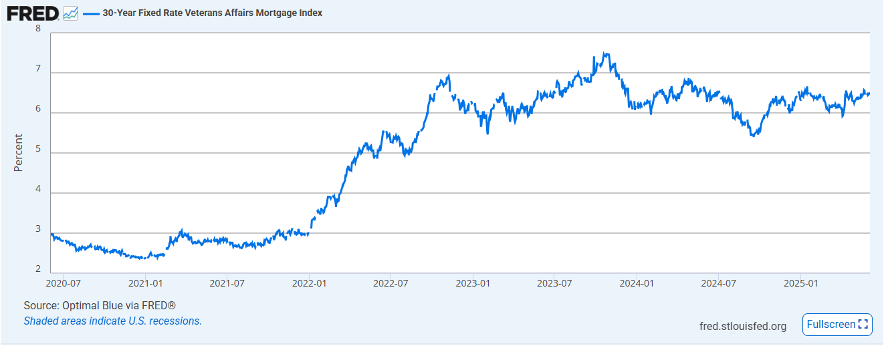
Cost of Money
United States Economy is fueled by access to capital
Cheap debt = higher prices

Slide 6
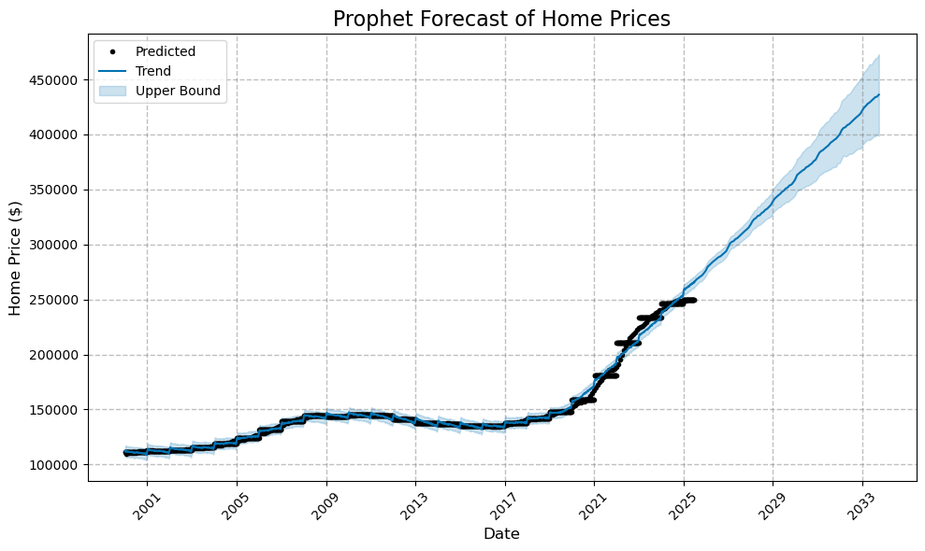
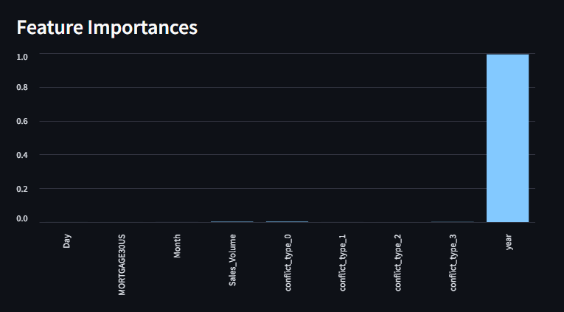
The future of housing
Prophet Modeling
Random Forest
Time is the only large impacting event when it comes to real estate prices

Slide 7
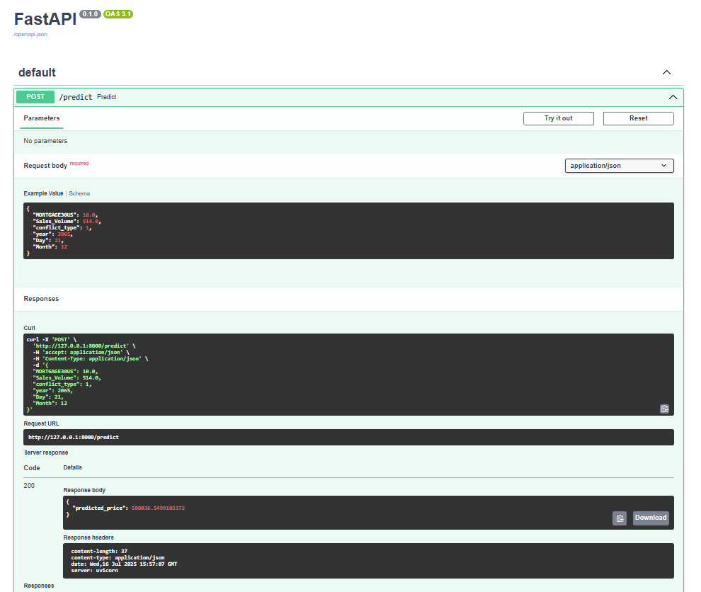
Linear Fastapi http://127.0.0.1:8000/docs

Slide 8
Summary
Military Towns Housing Market
Consistent pay
-Preferred lending rates (VA Loan)
Government protections from foreclosure and other
Hisotically shielded from external fluctuations except in case of Covid housing cost boom
National Trends
Changes in GDP and economic strength sway US capability and housing prices
Government oversight lower in comparison to government backed financing
Housing Market
- Exceptionally intricate model fueled by economic, political, international and emotional decision making
-International relationships create import and export costs as well as influence US economic strength which ties directly the the ability to lend capital, i.e., purchase major assets
- The US credit worthiness has been in flux as of late but historically known as the standard for international currency which creates strong lending environment at favorable rates

Slide 9

THANK YOU
Darian Gore
512-971-6900

